Slide 1

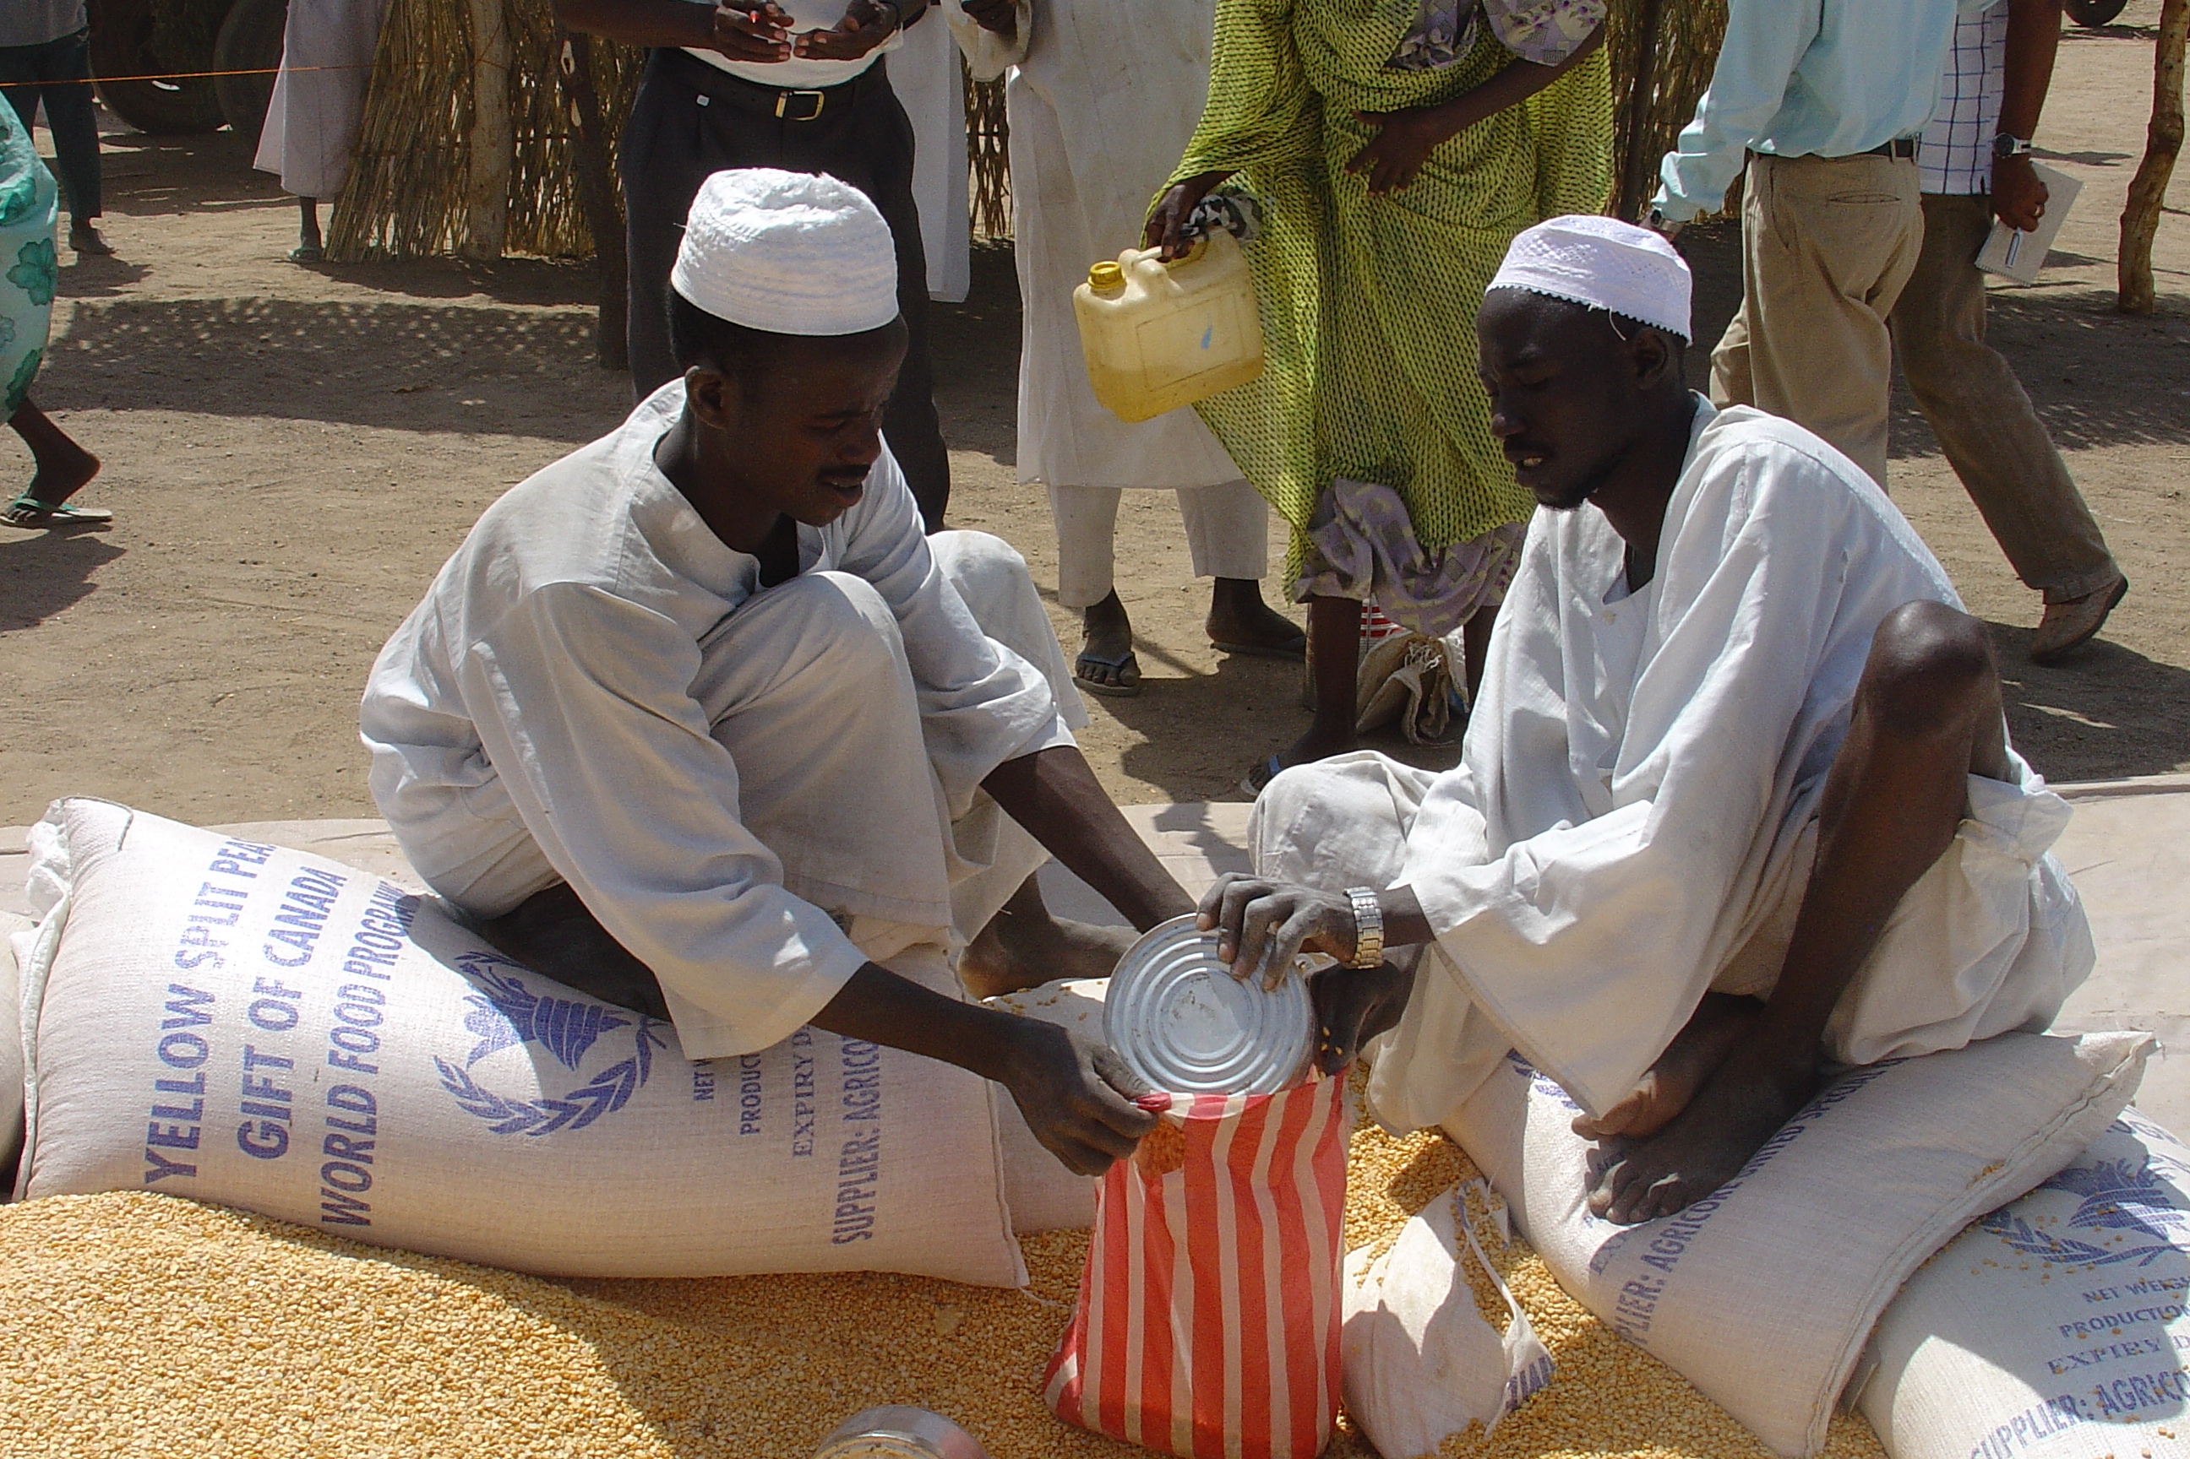
Developing Computational Tools to
Aid Hunger and Poverty Reduction
Christopher B. Barrett
Institute for Computational Sustainability
Cornell University
May 6, 2010

Slide 2
The challenge
Renewed interest and funding targeted toward hunger and poverty reduction.
Increased flexibility in instruments (e.g., no longer just food aid in responding to food emergencies).
Rapid growth in data availability.
Need to translate more dollars and data into better choices, now that there are choices to be made.
Need to know:
  who is poor or hungry and how to identify them?
  what is best response to help them?
Emerging computational challenges /opportunities.
4 brief examples follow.

Slide 3
Poverty maps
Identifying the poor is the first essential step
Poverty maps:
Use multiple data sets to estimate and map poverty patterns not directly measured.
Machine learning and related methods can permit more efficient use of data from varied sources.
New collaboration between Cornell economists and computer scientists
Example: 2002 Uganda poverty map

Slide 4
Targeting maps
Targeting the best response to reduce poverty
Targeting maps:
Machine learning methods enable more efficient estimation of spatially explicit, time-varying returns to different interventions, tapping multiple data sources.
Nascent collaboration between Cornell economists and computer scientists
Example: Uganda targeting map

Slide 5

Which response to address food insecurity?
Response analysis
Market information for food insecurity response analysis (MIFIRA):
Decision support tool for humanitarian agencies - in a given food emergency, do they distribute food or cash? If food, where to procure? Data mining and artificial intelligence tools can help a lot.
Nascent collaboration between Univ. of Rochester computer scientists, Cornell economists, international NGOs (CARE, Catholic Relief Services) and World Food Program.

Slide 6
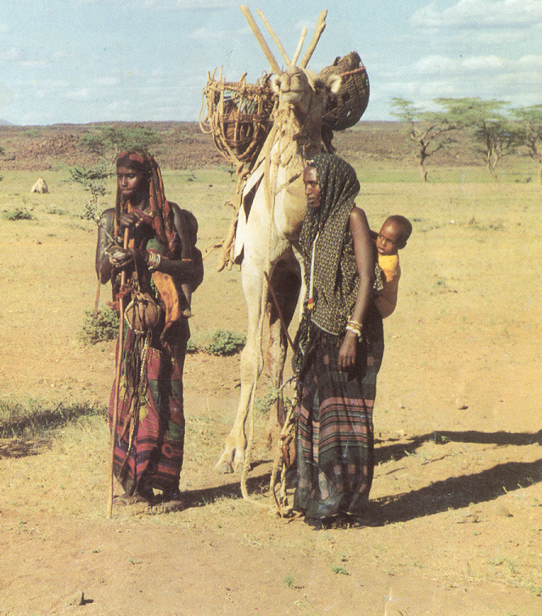
How to protect pastoral lives and livelihoods?
Enhancing adaptation
How to reinforce adaptive migration among poor east African pastoralists so as to avoid catastrophic herd collapse? Need to understand herder behavior. But structural estimation of spatio-temporally explicit pastoralist migration behavior infeasible using traditional econometric methods. Machine learning methods show considerable promise.
Ongoing collaboration between Cornell economists and computer scientists.

Slide 7

There is considerable demand among donors, international humanitarian organizations for effective decision support tools to help them make better use of newfound flexibility in aiding hunger and poverty reduction.
Thank you for your interest.
Conclusion

